Slide 1






Question time!
How many stages do you think there are in sleep?
2…
We guess that you probably think there are light and deep sleep.

Slide 2
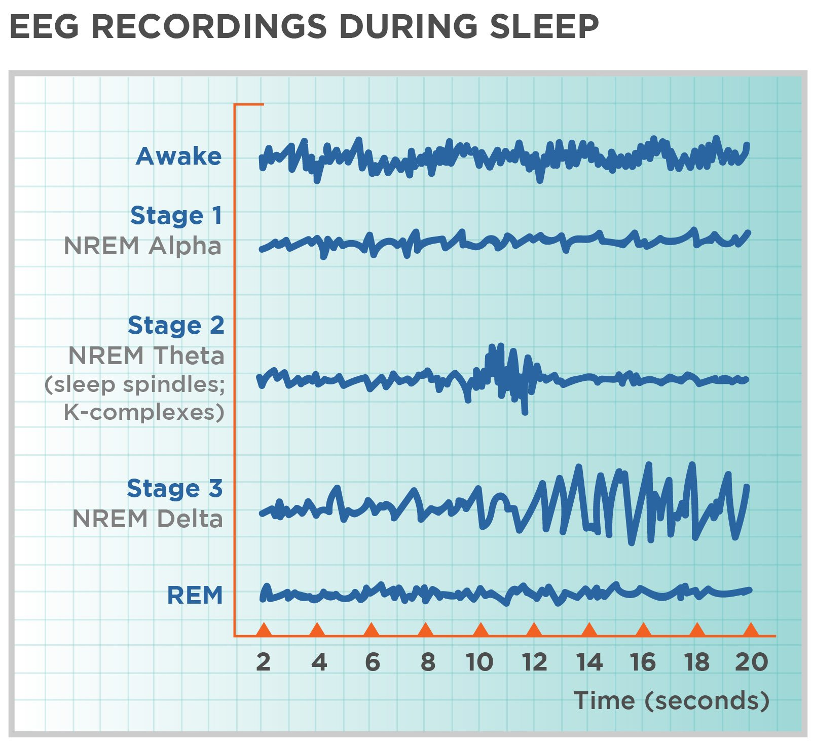
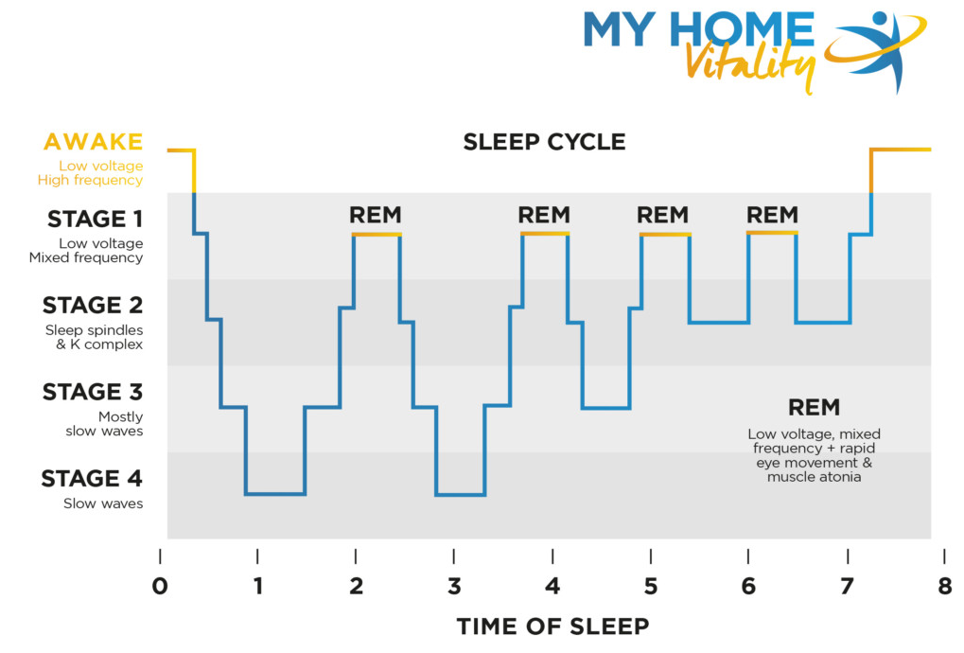
Stages of Sleep
Brain waves
Non-rapid eye movement, NREM
→ Stages 1-3
Rapid eye movement, REM
→ Stage 4
Notes:
Since sleep is complex, scientists have classified sleep into two states, NREM and REM. These two states are further divided into 4 stages according to different patterns of brain waves. The first stage is a transition between wakefulness and sleeping. The second stage is crucial for our learning. The third stage is responsible for our recovery from wakefulness and thermoregulation. These three stages are classified as Non-rapid eye movement state of sleep. While the rem state of sleep refers to the fourth stage, which is in charge of development and preparation for wakefulness.

Slide 3
Non-rapid eye movement, NREM
The first type of sleep you enter.
3 stages.

Slide 4


The Characteristics & Stages of NREM Sleep
STAGE 1
Short – 5 to 10 minutes normally
Hypnic jerks

Slide 5
The Characteristics & Stages of NREM Sleep
STAGE 1
STAGE 2
Short – 5 to 10 minutes normally
Hypnic jerks
Eye movement stops, heart rate slows and body temperature decreases

Slide 6

The Characteristics & Stages of NREM Sleep
STAGE 1
STAGE 2
STAGE 3
Short – 5 to 10 minutes normally
Hypnic jerks
Eye movement stops, heart rate slows and body temperature decreases
No eye movement or muscle activity
Feel groggy and disoriented if you’re woken
up

Slide 7


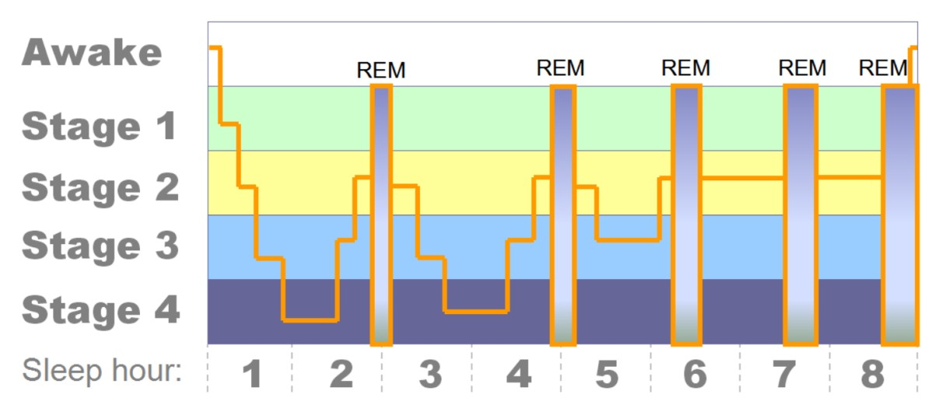


The importance of NREM sleep
During non-REM stages, your body:
Builds bone and muscle.
Repairs and regenerates tissues.
Strengthens the immune system.

Slide 8


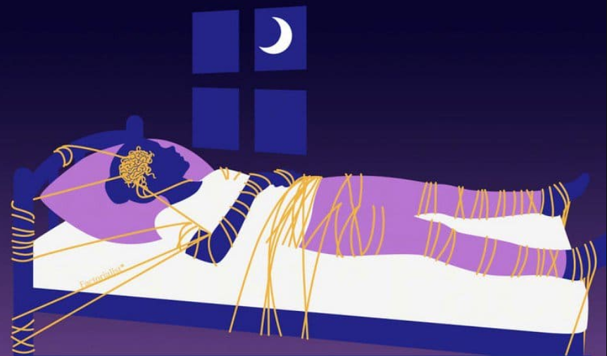
REM
Rapid eye movement (REM)
Brain activity: near-waking level
The stage when we experience most of our dreams
Muscles paralyzed
Brainstem suppresses motor activity
REM Sleep Behavior Disorder (RBD)
Sleepwalking
Neurodegenerative diseases
Notes:
https://www.sleepresolutions.com/blog/rem-sleep-what-it-is-why-we-need-it
https://www.awesomeinventions.com/wp-content/uploads/2016/03/rem-paralysis.jpg
https://www.wise-geek.com/what-is-rem-behavior-disorder.htm

Slide 9
REM and creativity
Integrate different information into a schema
Boost of creativity
Notes:
https://medium.com/@jahnavimandadapu/the-dream-that-revealed-the-structure-of-benzene-3c7e270c90c

Slide 10
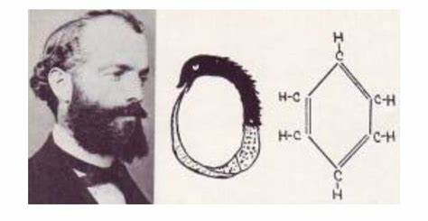
REM and creativity
Integrate different information into a schema
Boost of creativity
Friedrich August Kekule
Structure of benzene
Notes:
https://medium.com/@jahnavimandadapu/the-dream-that-revealed-the-structure-of-benzene-3c7e270c90c

Slide 11

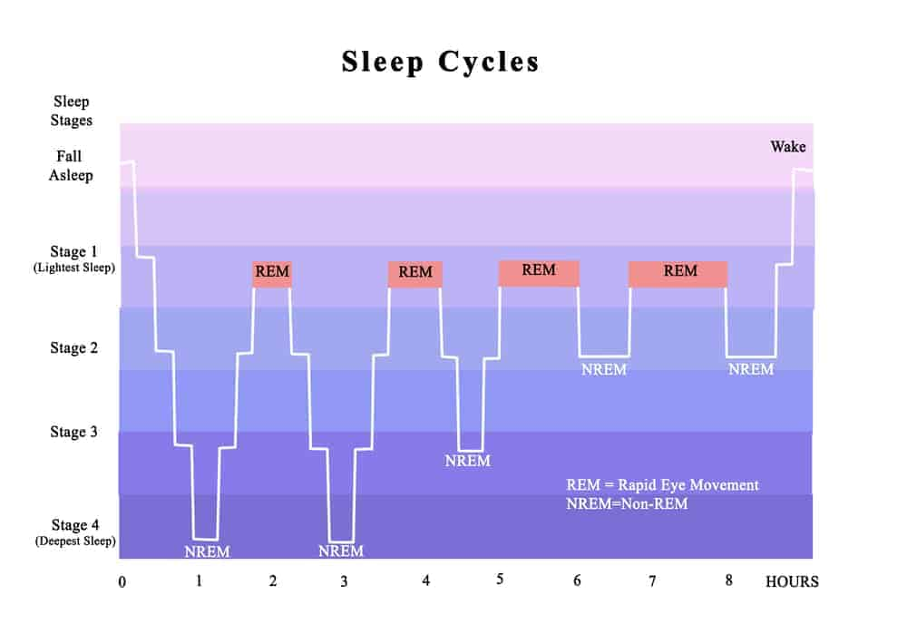
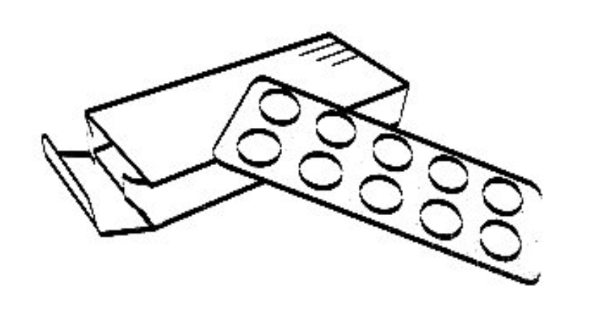
How to improve your sleep
×
LIGHT
Sleep n×1.5 hours
keep a regular sleep routine
NOISE
×
℃

Slide 12
Take home message
As you sleep, your brain cycles through four stages, including NREM (1 to 3 stages) and REM (the 4 stage).
Each stage has unique features or functions.
Your sleep habits should obey the sleep cycle.

Slide 13
Reference
ALAM, N. (2013) NREM Sleep: Anatomy and Physiology. IN: KUSHIDA, C. (Eds.) Encyclopedia of Sleep, London:Academic Press, pp453-459.
CALANDRA-BUONAURA, G., ALESSANDRIA, M., LIGUORI, R., LUGARESI, E. & PROVINI, F. (2014) Hypnic jerks: neurophysiological characterization of a new motor pattern. Sleep Med. 15(6), 725-727.
Pana-Cryan, R. (2020) QuickStats: Percentage of Currently Employed Adults Aged ≥18 Years Who Reported an Average of ≤6 Hours of Sleep per 24-Hour Period, by Employment Category — National Health Interview Survey, United States, 2008–2009 and 2017–2018 [online]. Centers for Disease Control and Prevention. Available from: https://www.cdc.gov/mmwr/volumes/69/wr/mm6916a5.htm [Accessed 07/12/2021].
Mantua, J. & Simonelli, G. (2019) Sleep duration and cognition: is there an ideal amount? Sleep. 42(3), zsz010.

Slide 14
Image Credits
https://www.sleepresolutions.com/blog/rem-sleep-what-it-is-why-we-need-it
https://www.awesomeinventions.com/wp-content/uploads/2016/03/rem-paralysis.jpg
https://www.wise-geek.com/what-is-rem-behavior-disorder.htm
https://www.shutterstock.com/zh/search/mental+disorder+cartoon
https://www.kindpng.com/imgv/iRRxhhh_shocked-png-page-hand-over-mouth-cartoon-transparent/
http://miratico.com/every-night-sleep-descended-heavens/stages/
http://www.end-your-sleep-deprivation.com/what-is-sleep.html

Slide 15

Thanks for watching

